Slide 1
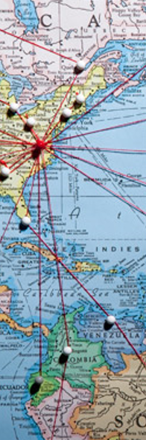

Emerald city travel recommendations
Personalizing Travel

Slide 2
INSPIRATION
“Dump the Eiffel Tower” – Anthony Bourdain
Seattle Travel
Millennial Travel Trends
Millennial Prolictivity
Art, music, shopping, outdoor recreation, cuisine and coffee
40+ million visitors per year
$7.8 billion in spending
Spend $200 billion on travel (2018)
5.6 trips per year (vs. 3.5 for baby boomers)
75% use mobile travel apps
Two thirds of millennials would appreciate personalized travel recommendations
Demand unique experiences and desire to see life through the lenses of a local
More likely to support local businesses
Notes:
This is what inspired a personalized travel destination recommendation application:
Utilized Yelp review data – Yelp reviews are typically very thorough, critiques
Use similarities found in Yelp review data of different businesses to generate recommendations

Slide 3
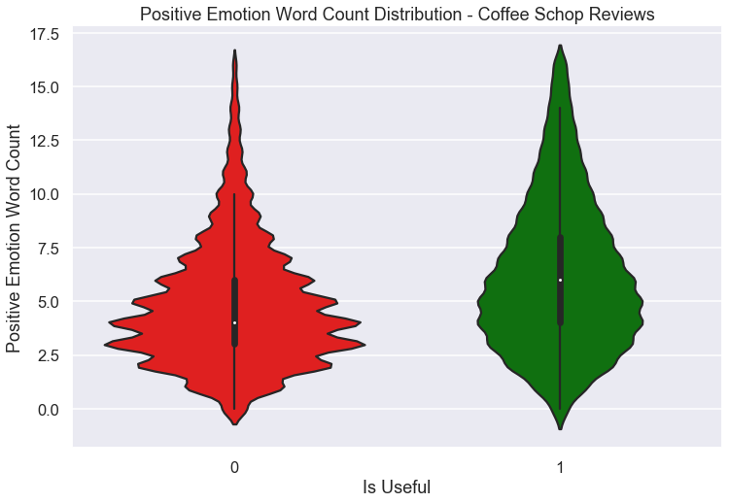
predict useful reviews
Predict Useful Reviews
Unsuccessful ~68% Accuracy
Yelp Academic dataset
Binary classification problem – one or more “useful” votes (1), zero votes (0)
Engineered many features
Various models
Ultimately unreliable metric (“useful’ votes)
Notes:
Because we are using solely review data to make our recommendations, I wanted to make sure that only “useful” reviews were being used to compare businesses
- Yelp academic dataset
Unsuccessful at predicting though certain trends were discovered
Yelp academic dataset
Binary problem
Engineered features included positive emotion word count, average sentence subjectivity (lower the better), and total unique word count – these examples proved relevant
Models tested included logistic regression, decision trees, ensemble methods, SVM – all with similar results
Ultimately metric appeared to be unreliable

Slide 4
Phase ii: MOBILE Application concept
TRAVELER INPUT
Select coffee shop, boutique store, or nightlife category
- Input URL of favorite local business of relevant category
Scrape Yelp reviews of traveler’s favorite business in their hometown
APPLICATION OUTPUT
Compare scraped review data to Seattle businesses to make unique recommendations

Slide 5
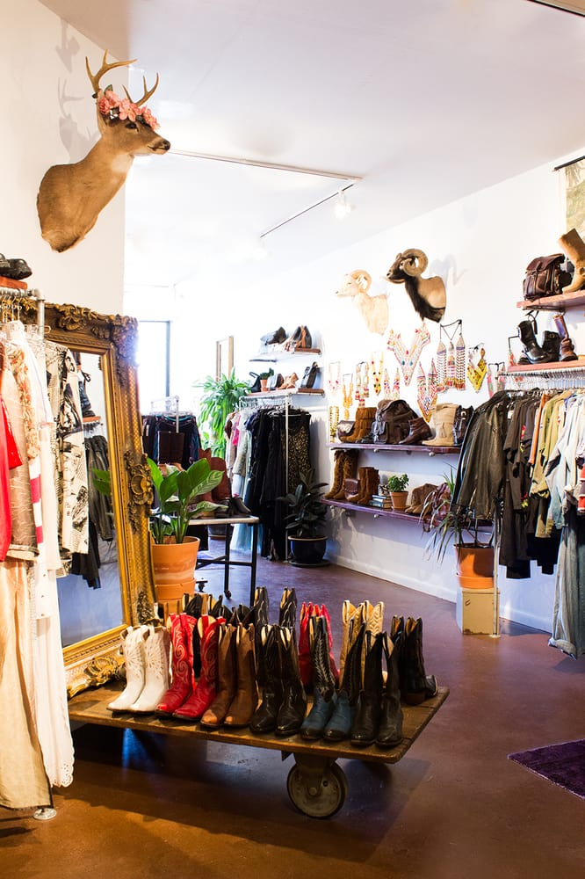
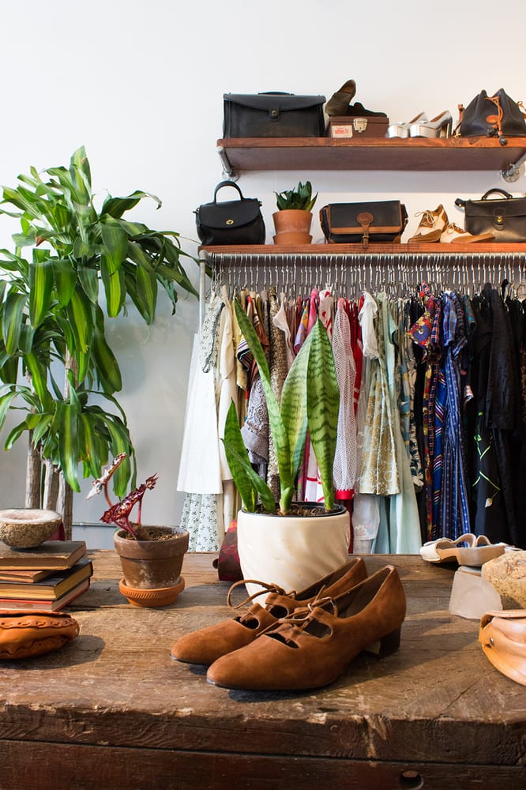
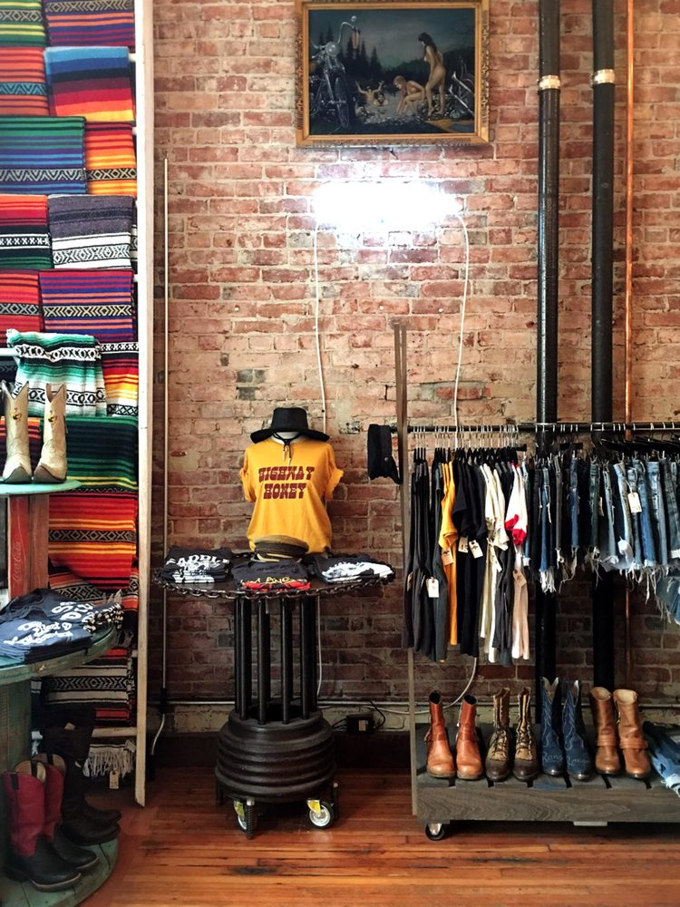
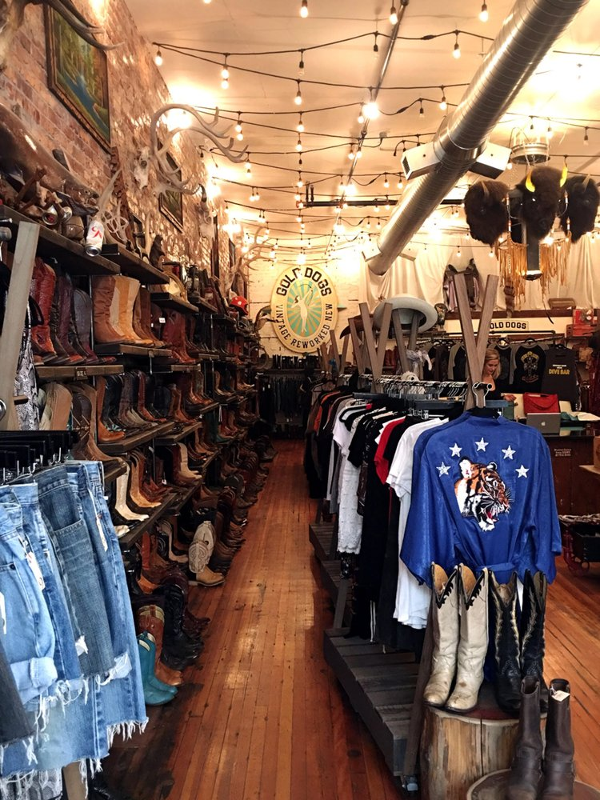
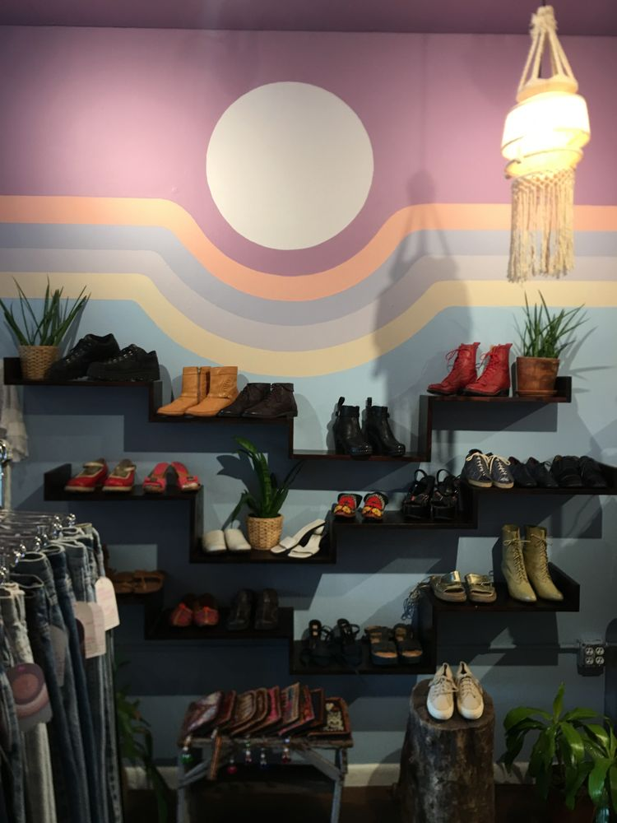
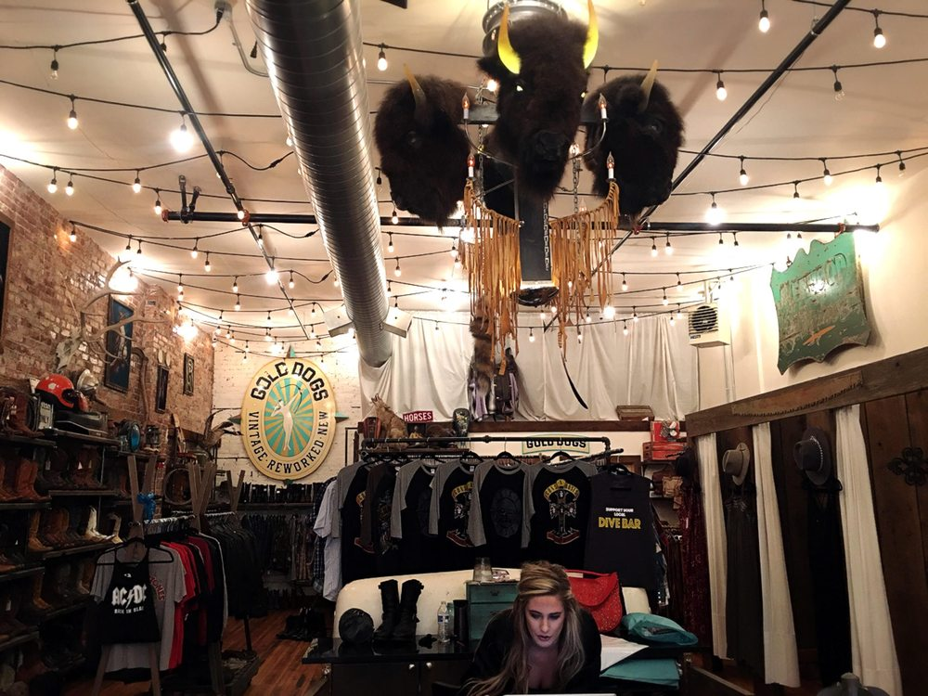
Sydney from ATX
Sydney loves searching for hidden treasures in vintage stores and frequents “Charm School Vintage” in her home city, Austin, TX. She will be visiting Seattle next weekend and would like recommendations on personalized shopping experiences.
Charm School Vintage, ATX
recommends…
Gold Dogs, Seattle

Slide 6


Future work
Broaden Application
Incorporate Features Other than Reviews
Explore Advanced NLP Techniques
More cities
More destination options (restaurants, hiking trails, family fun, and more)
Collaborative vs. content-based recommendation systems
Hybrid system
N-grams
Word embeddings

Slide 7
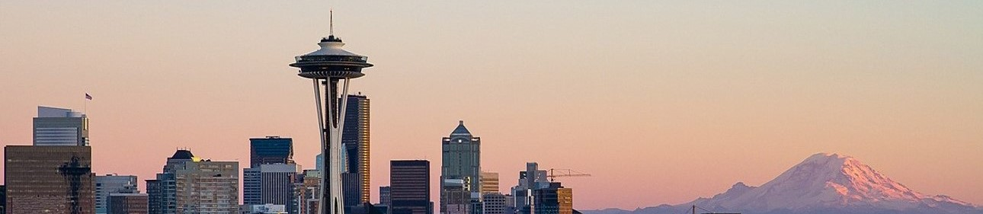


THANK YOU
Braydon Charles Janecek
braydoncharlesjanecek@gmail.com
https://bcjanecek.github.io/

